Slide 1

Verizon Technopedia Model
Presentation
presented by
Nancy Chen, Julia Ding, Vera Dureke, Saman Fatima and Viswaretas Kotra

Slide 2
Introduction
Project Overview
Project Objective
Model & Evaluation
Conclusion
Agenda

Slide 3





Meet the Team
Nancy Chen
Stony Brook University
Vera Dureke
Indiana University East
Julia Ding
Columbia University
Saman Fatima
University of Virginia (UVA)
Viswaretas Kotra
UTD

Slide 4



Our AI Studio TA and Challenge Advisors
Zening Wang
AI Studio TA
Brian Kowalczyk
Challenge Advisor
David Salter
Challenge Advisor

Slide 5
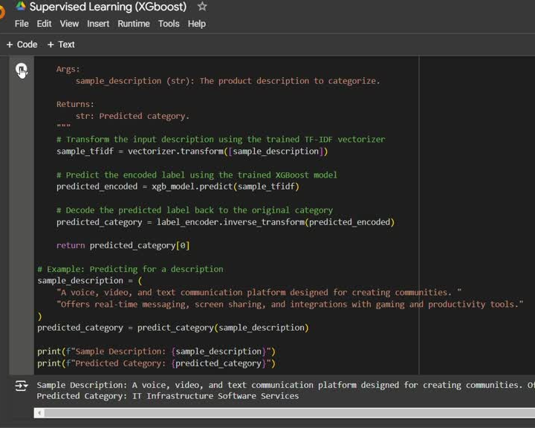
Project Objective
Establish a system that is able to intake some of a few key data points about a technology product and assign a product categorization to it.

Slide 6
Timeline
Data Collection & Preprocessing
Gathered relevant datasets, cleaned text data, removed noise, and prepared data for modeling.
Model Evaluation & Refinement
Evaluated model performance, refined hyperparameters, and implemented interpretability techniques.
October 2024
December 2024
September 2024
November 2024
Model Selection & Initial Training
Chose XGBoost, Deep Learning (RNN), and BERT models; conducted initial training and tuning.
Final Presentation & Documentation
Consolidated findings, created final presentation, and documented insights, ready for project delivery.

Slide 7




Resources We Leveraged
  Datasets: Publicly available product datasets and internal Verizon data (where applicable) for product categorization.
  Tools & Libraries:
    Python, Pandas, and Scikit-Learn for data processing and baseline modeling.
    XGBoost as a benchmark model.
    TensorFlow/PyTorch for deep learning.
    Hugging Face API for fine-tuning GPT.
  Modeling & Compute:
    XGBoost: Trained on cloud CPUs/GPUs; used as a baseline.
    Multishot Learning: Leveraged multi-example training for better generalization in product categorization tasks, utilizing GPUs to handle high-dimensional data effectively..
    GPT with BERT: Fine-tuned on Verizon data using high-performance GPUs for nuanced, context-aware categorization.
  Research & Frameworks: Guided by studies on text classification and model interpretability tools (e.g., SHAP for XGBoost, attention visualization for deep learning).

Slide 8
Data Understanding & Data Preparation

Slide 9
Exploratory Data Analysis
Objective: Build an NLP model to categorize Verizon's software products by analyzing product descriptions.
Data Composition:
Dataset includes Enterprise Software Products with fields for product name, vendor, category, and description.
Focus on data quality, distribution, and content structure to guide model training.
Data Quality:
No missing values or duplicates in key datasets.
Initial exploration of text data highlights difference in description lengths.
Notes:
Nancy: To start off,our objective supports an NLP model to categorize Verizon's software products using product descriptions as the primary feature.
For Data Composition: We’re working with fields like product names, vendors, and descriptions. Focusing on descriptions will help us capture patterns for accurate categorization.
Data Quality: Our data has no missing values or duplicates. Initial checks reveal variation in description lengths, which is essential for identifying where more detail or data may enhance model performance.

Slide 10
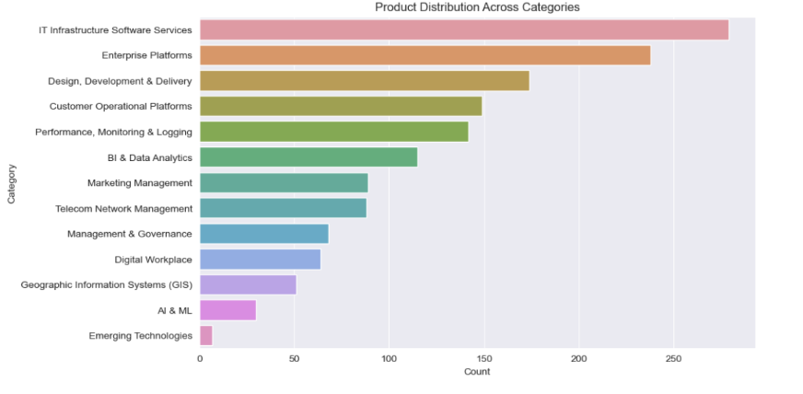
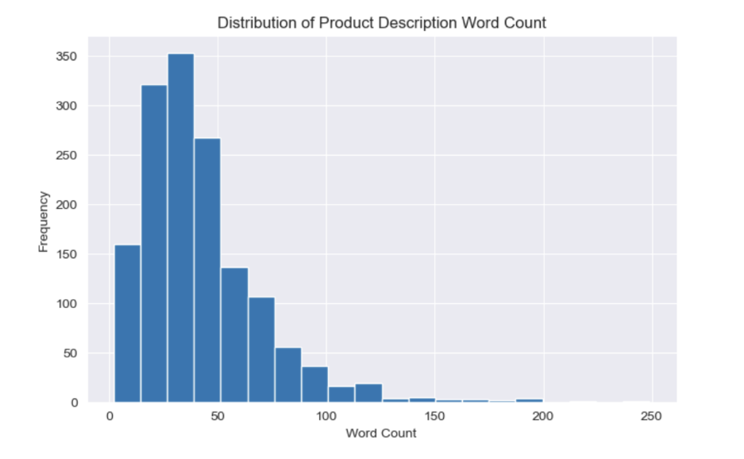
Exploratory Data Analysis
Notes:
To start off, Since we are working with NLP project, for the EDA, we first looked at features such as word counts, product distributions for us to better understand the differences between each category, and if more data is needed. On the left for example, we can We can see that there is less products for ai & ml and emerging technologies, we can consider looking more into these products later on, The majority of the product descriptions contain fewer than 50 words. This is indicated by the high frequency (y - axis) on the side (highest between 25-50). The high frequency of words that
are lower than 20 words might indicate that we could need more detail for those words.

Slide 11
Common Words and N-Gram Analysis
N-Gram Analysis:
  Extracted common 1-gram and 2-gram phrases within each category.
  Unique Keywords: Highlighted terms that are distinctive to specific categories, capturing category-specific language.
  Common Keywords: Found shared terms across categories, reflecting overarching themes within the dataset.
TF-IDF Insights:
  Focused on terms with high TF-IDF scores to distinguish category-relevant language.
  Distinctive Words: Identified important terms unique to each category, which are crucial for model differentiation.
Notes:
After we have better understood how our data looked, we started looking at key features,the goal here was to identify both unique and common keywords across different categories. This helps the model learn what language is typical for each category and improves its accuracy.
N-Gram Analysis: We extracted common 1-gram and 2-gram phrases, which helped us identify terms that are either distinctive to specific categories or shared across multiple ones. The unique terms are particularly valuable, as they help the model differentiate between categories.
TF-IDF Insights: Using TF-IDF, we focused on the words that hold the most weight in each category. These high-scoring terms are critical for understanding what makes each category distinct, allowing us to fine-tune the model’s categorization process.

Slide 12
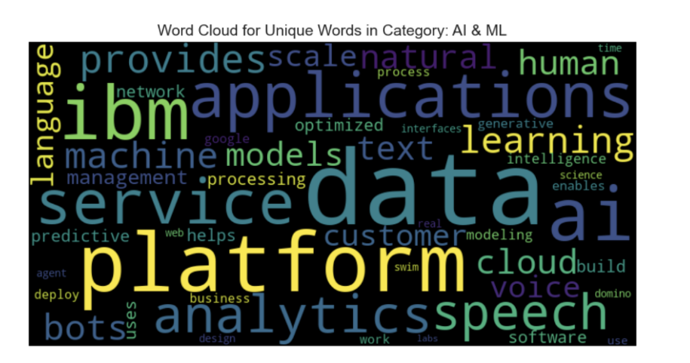
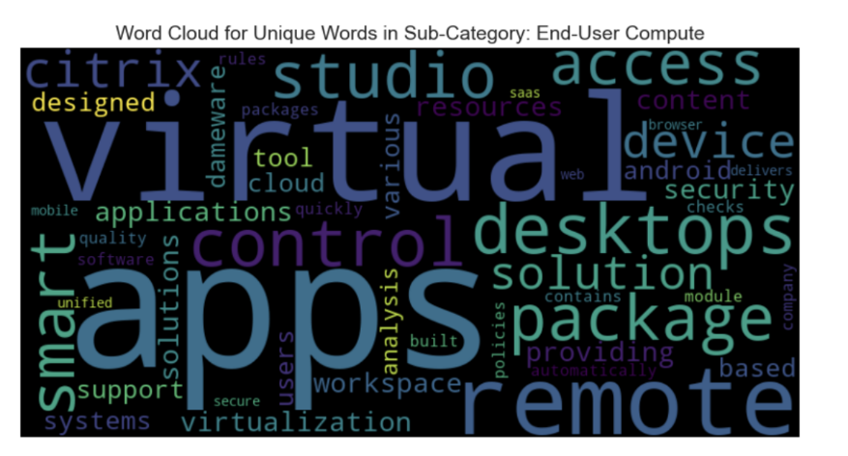
Common Words and N-Gram Analysis
Notes:
As we can see from the word clouds, we egenderate d unique word word clouds for our category and sub category to see which key words were unique to each category, this can be beneficial in the future model development process where we will be able to know the key words that categorize each category

Slide 13
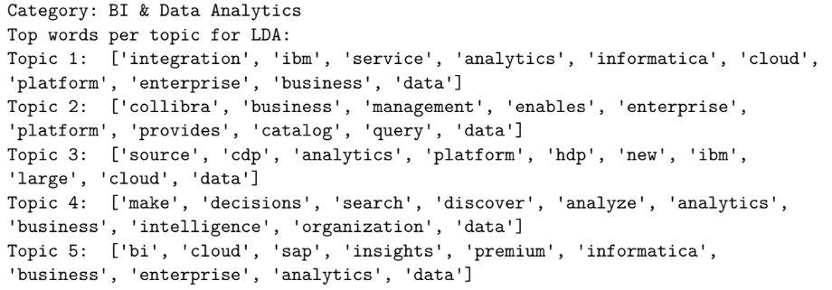
LDA (Linear Discriminant Analysis)
Notes:
In addition we also used Linear discriminant analysis Can help with the following: identify Key Themes: LDA shows the main words that describe
each category, like “data” and “analytics” for BI & Data Analytics or “service” and “network” for Telecom Network Management.
Useful Features for Models: The common words found by LDA can be used to help machine learning
models categorize new products by focusing on words that stand out in each category.
Improve Product Descriptions: LDA helps optimize product descriptions by making sure important
terms are included, making it easier to categorize and find products.
data BI & Data Analytics: The topics highlight the focus on data inte-
gration, analytics, and business intelligence. Common terms like “data,” “analytics,” “platform,” and “cloud” suggest a strong emphasis on data-driven decision-making and cloud-based platforms. There are also references to specific tools like Informatica and Collibra, indicating key players in
this space.

Slide 14
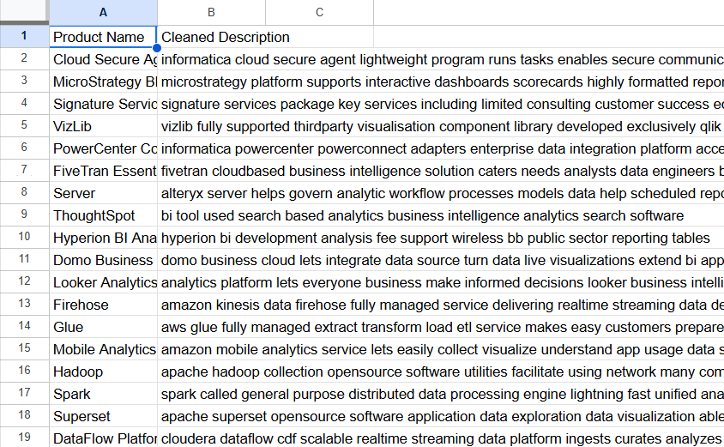
Data Preparation
Data Cleaning and Preprocessing
  Remove Irrelevant Data: HTML tags, special characters, and unnecessary numbers.
  Lowercasing: Convert all text to lowercase for consistency.
  Remove Stop Words: Exclude common words (e.g., "the," "is") that don't add significant meaning.
  Handling Missing Data: Fill, remove, or flag missing text entries.
  Punctuation Removal: Remove or retain punctuation based on the use case.
  Text Normalization: convert abbreviations and expand contractions.
  Deliverable: Clean and well-structured text data, ready for tokenization and further processing.
Notes:
Saman

Slide 15
Feature Engineering

Slide 16
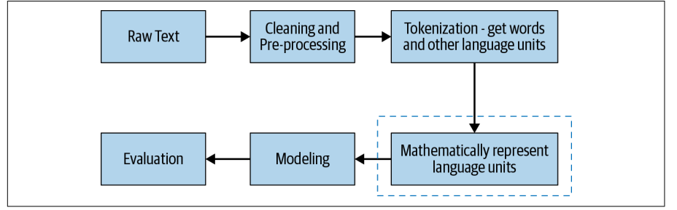
Feature Engineering
Definition:
  The process of selecting, transforming, and creating features to optimize machine learning model performance.
Importance:
  Improves model accuracy and performance.
  Reduces complexity of models by emphasizing key patterns in the data.
Steps:
  Data Understanding:
    Identify critical input variables: product descriptions, names, categories, and subcategories.
    Understand relationships between features and target labels.
  Data Transformation:
    Apply TF-IDF Vectorization to represent text numerically.
    Tokenize text (split into individual words) for detailed processing.
    Encode categorical labels (categories and subcategories) into numerical values.
Notes:
Saman

Slide 17
Feature Engineering
What We Did:
  Text-Based Features:
    Cleaned text: lowercased, removed punctuation, and stopwords.
    Applied TF-IDF to product descriptions and names separately.
    Combined numerical representations into a unified feature matrix.
  Label Preparation:
    Encoded taxonomy_category and taxonomy_sub_category fields into numeric labels.
  Handling Imbalances:
    Filtered out underrepresented labels to improve model generalization.
    Used stratified train-test splitting for balanced data distribution.
Notes:
Saman

Slide 18
Modeling & Evaluation

Slide 19
Our Approach
  XGBoost:
    Used as the baseline model with grid search optimization (e.g., tuning parameters like max_depth and learning_rate) and validated through 5-fold cross-validation.
    Performance: Achieved 57% accuracy with a 52 % F1-score.
  Multishot Learning:
    Leveraged LSTM networks to capture sequential patterns in text, with optimizations like dropout regularization and early stopping.
    Performance: Reached 60% accuracy, but with a lower F1-score of 39%
  GPT Model (BERT):
    Fine-tuned a pre-trained BERT model for product categorization, utilizing its contextual embeddings to better handle nuanced textual data.
    Performance: Delivered 52% accuracy and an F1-score of 38%

Slide 20
Model Comparison
Model Name | Description | Results | Pros | Cons
XGBoost | Gradient-boosting algorithm for structured/tabular data. | Accuracy: 57%. F1-scores vary significantly across categories (e.g., 0.30–0.62). Certain categories, like "AI & ML," underperformed. | Handles structured data well, supports missing values, and is computationally efficient. | Struggles with unstructured data, such as text, and shows poor performance in some categories.
Multishot Learning | A machine learning approach where the model is trained with multiple examples per class to generalize well. | Accuracy: 60%. Achieved better precision and recall for some categories, e.g., "BI & Data Analytics" (F1: 0.63). | Better at generalization than single-shot approaches. | Requires more data than few-shot learning; some categories (e.g., "Emerging Technologies") underperform.
Finetuned Pretrained | A model pre-trained on large datasets and fine-tuned for specific classification tasks. | Accuracy: 52%. Macro-average F1-score: 0.38; Weighted-average F1-score: 0.48. Some epochs improved performance slightly but struggled with imbalanced data. | Leverages prior knowledge, better for text data, adaptable to various downstream tasks. | Computationally expensive, underperforms when fine-tuning is not optimized or data is imbalanced.

Slide 21
Model Comparison (Top 5 Categories)
Model Name | Description | Results | Pros | Cons
XGBoost | Gradient-boosting algorithm for structured/tabular data. | Accuracy: 64%. Macro-average F1-score: 0.59. Categories like "Performance, Monitoring & Logging" (F1: 0.73) performed well. | Handles structured data well, supports missing values, and is computationally efficient. | Struggles with imbalanced data (e.g., "IT Infrastructure Software Services" had lower recall).
Multishot Learning | A machine learning approach where the model is trained with multiple examples per class to generalize well. | Accuracy: 66%; Improved performance in categories like "Enterprise Platforms" (F1: 0.72). | Strong generalization with improved precision and recall in key categories. | Requires more data for rare classes and underperforms in some, like "Design, Development & Delivery."
Deep Learning (LTSM) | Sequential neural networks fine-tuned for text data. | Accuracy: 50%; Macro-average F1-score: 0.49; Weighted-average F1-score: 0.51. | Captures sequential patterns, adaptable for text tasks, and improves over epochs. | Computationally expensive, struggles with imbalanced data, and inconsistent F1-scores.
Deep Learning (Multitask MLT) | A multitask learning model using BERT for feature extraction, optimized for joint category predictions | Accuracy: 67%. Macro-average F1-score: 0.64. Categories like "IT Infrastructure Software Services" (F1: 0.71) performed well | Captures sequential patterns, adaptable for text tasks, and improves over epochs. | Computationally expensive, struggles with imbalanced data, and inconsistent F1-scores.

Slide 22
Final Thoughts

Slide 23
What We Learned
  Accuracy Trends:
    Multishot Learning demonstrated the highest accuracy (60%) among the models, with relatively consistent performance across most categories.
    XGBoost achieved moderate performance, performing well in structured categories but struggling with text-heavy classifications.
    Finetuned Pretrained Model had the lowest accuracy (52%) due to challenges with imbalanced data and limited text representation in certain categories.
  Category-Level Performance:
    "IT Infrastructure Software Services" and "Enterprise Platforms" consistently performed well across models, suggesting these categories are well-represented and distinguishable in the data.
    "AI & ML" and "Emerging Technologies" were underrepresented and poorly classified by all models, indicating a need for better data representation or augmentation in these categories.
  Balance of Precision and Recall:
    Multishot Learning balanced precision and recall more effectively than XGBoost and Finetuned Pretrained models, especially in categories like "BI & Data Analytics."
    XGBoost and Finetuned Pretrained models faced challenges balancing these metrics, leading to significant variability in F1-scores across categories.

Slide 24

Potential Next Steps
  Model Refinement:
    Optimize XGBoost with hyperparameters.
    Solve imbalances with oversampling or synthetic data
  Data Enhancement:
    Expand the dataset by collecting more examples from rare categories (e.g., "AI & ML").
    Improve text processing by tokenizing and standardizing complex descriptions.
    Use active learning to prioritize adding high-value samples for better model training.
  Deployment:
    Integrate GPT-powered APIs for real-time predictions and responses.
    Develop user feedback tools to collect insights and improve model accuracy iteratively.
  Future Research:
    Experiment with models for enhanced text classification.
    Explore classification hierarchies to classify data more accurately while simplifying complex category structures.

Slide 25
Open to Questions!

